Slide 1
Extracting Linked Data from Alma
Via APIs
Yoel Kortick | May 2026

Slide 2
Agenda
Introduction
The Linked Data Integration Profile
The syntax to use APIs for Linked Data
The sample bibliographic records
Using the APIs
Using the APIs in National Taiwan University

Slide 3

Introduction

Slide 4
Introduction
Linked data can be extracted from Alma via APIs and via the general publishing profile (see separate presentation regarding the general publishing profile)
After extracting the data, it can be used in discovery for aiding the user.

Slide 5
The Linked Data Integration Profile

Slide 6
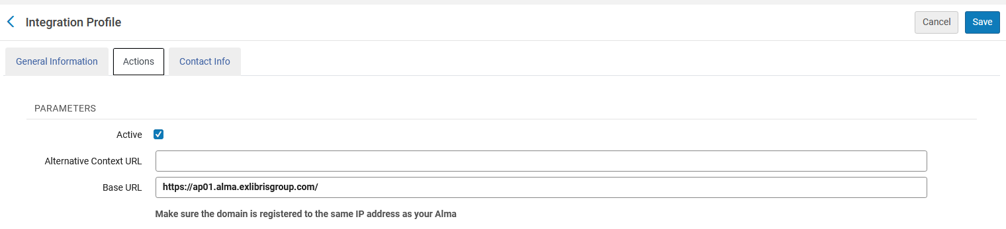
The Linked Data Integration Profile
To use the APIs for linked data a Linked Data integration profile must be set to active.
See also “To configure the linked data integration profile for your institution” at Linked Data.
The integration profile is accessed at “Configuration > General > External Systems > Integration Profiles”

Slide 7
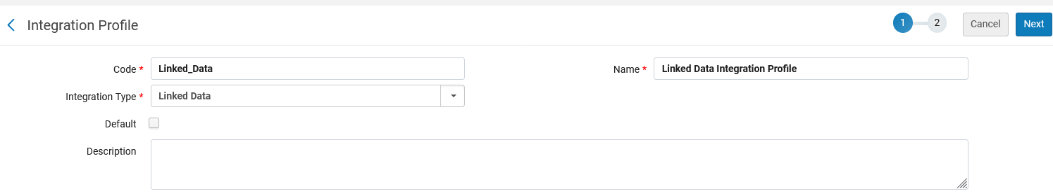
The Linked Data Integration Profile
If you do not yet have an integration profile of type Linked Data, you can add a new profile from “Configuration > General > External Systems > Integration Profiles”
Under Code, enter a unique code for the new integration type.
Under Name, enter a unique name for the new integration type.
Under Integration Type, select Linked Data.
Click “Next”

Slide 8
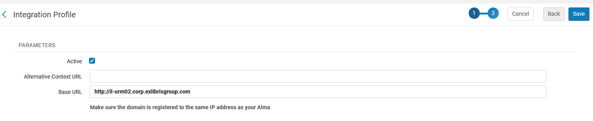
The Linked Data Integration Profile
Select “Active” and “Save”

Slide 9
The syntax to use APIs for Linked Data

Slide 10
The syntax to use APIs for Linked Data
The syntax to use APIs is as follows:
For format JSONLD
  https://open-na.hosted.exlibrisgroup.com/alma/{Institution Code}/bibs/{MMSID}.jsonld
For format BIBFRAME
  https://open-na.hosted.exlibrisgroup.com/alma/{Institution Code}/bf/entity/instance/{MMSID}
For format RDA
  https://open-na.hosted.exlibrisgroup.com/alma/{Institution Code}/rda/entity/manifestation/{MMSID}

Slide 11
The sample bibliographic records

Slide 12
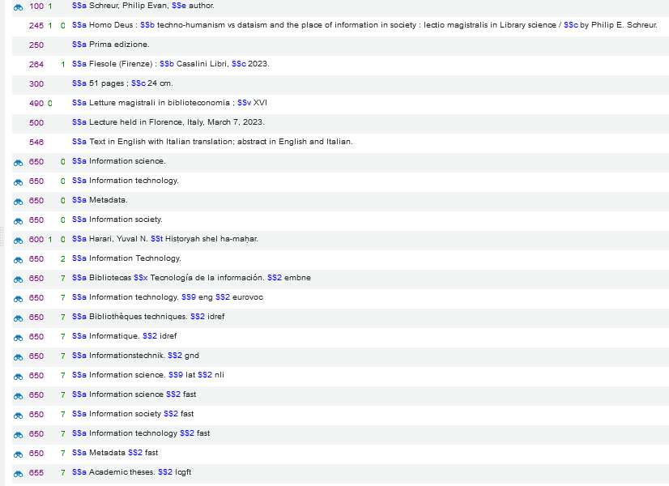
The sample bibliographic records
First record:
This is MMSID 99520387200121
LCNAMES
LCSH
MESH
National Library of Spain (SpMaBN)
European Union Vocabularies
Faceted Application of Subject Terminology
Deutsche Nationalbibliothek
National Library of Israel
Library of Congress Genre/Form Terms vocabulary

Slide 13
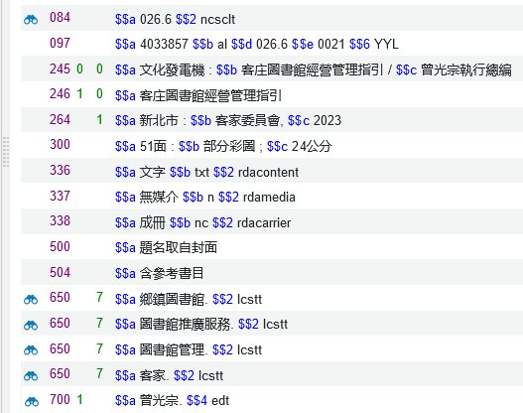
The sample bibliographic records
Second record:
This is MMSID 99521087800121
A heading linked to the Classification Scheme NCSCLT
A heading linked to the Subject Term LCSTT
A heading linked to the Name Authority TWNAF

Slide 14
Using the APIs

Slide 15
Using the APIs
The syntax for the first record MMSID 99520387200121 in institution EXLDEV1_INST-eu is as follows:
For format JSONLD
  https://open-na.hosted.exlibrisgroup.com/alma/EXLDEV1_INST-eu/bibs/99520387200121.jsonld
For format BIBFRAME
  https://open-na.hosted.exlibrisgroup.com/alma/EXLDEV1_INST-eu/bf/entity/instance/99520387200121
For format RDA
  https://open-na.hosted.exlibrisgroup.com/alma/EXLDEV1_INST-eu/rda/entity/manifestation/99520387200121

Slide 16
Using the APIs
The syntax for the second record MMSID 99521087800121 in institution EXLDEV1_INST-eu is as follows:
For format JSONLD
  https://open-na.hosted.exlibrisgroup.com/alma/EXLDEV1_INST-eu/bibs/ 99521087800121.jsonld
For format BIBFRAME
  https://open-na.hosted.exlibrisgroup.com/alma/EXLDEV1_INST-eu/bf/entity/instance/ 99521087800121
For format RDA
  https://open-na.hosted.exlibrisgroup.com/alma/EXLDEV1_INST-eu/rda/entity/manifestation/ 99521087800121

Slide 17
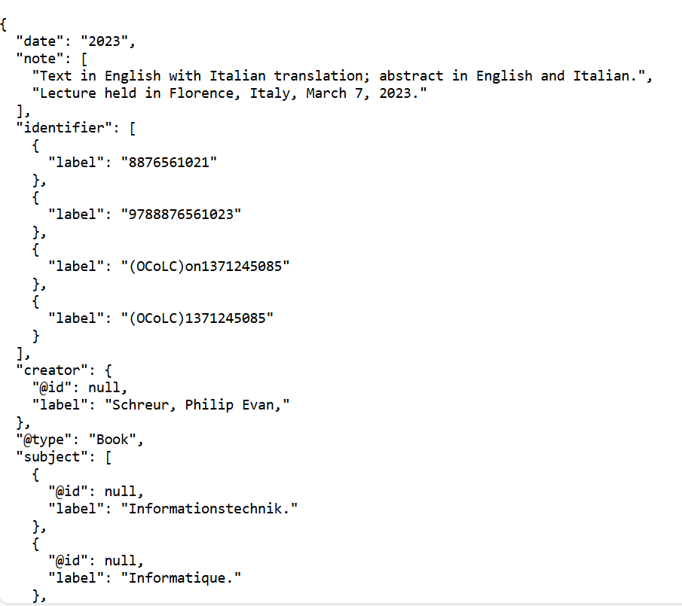
Using the APIs
Here is part of the first record in JSONLD using
https://open-na.hosted.exlibrisgroup.com/alma/EXLDEV1_INST-eu/bibs/99520387200121.jsonld

Slide 18
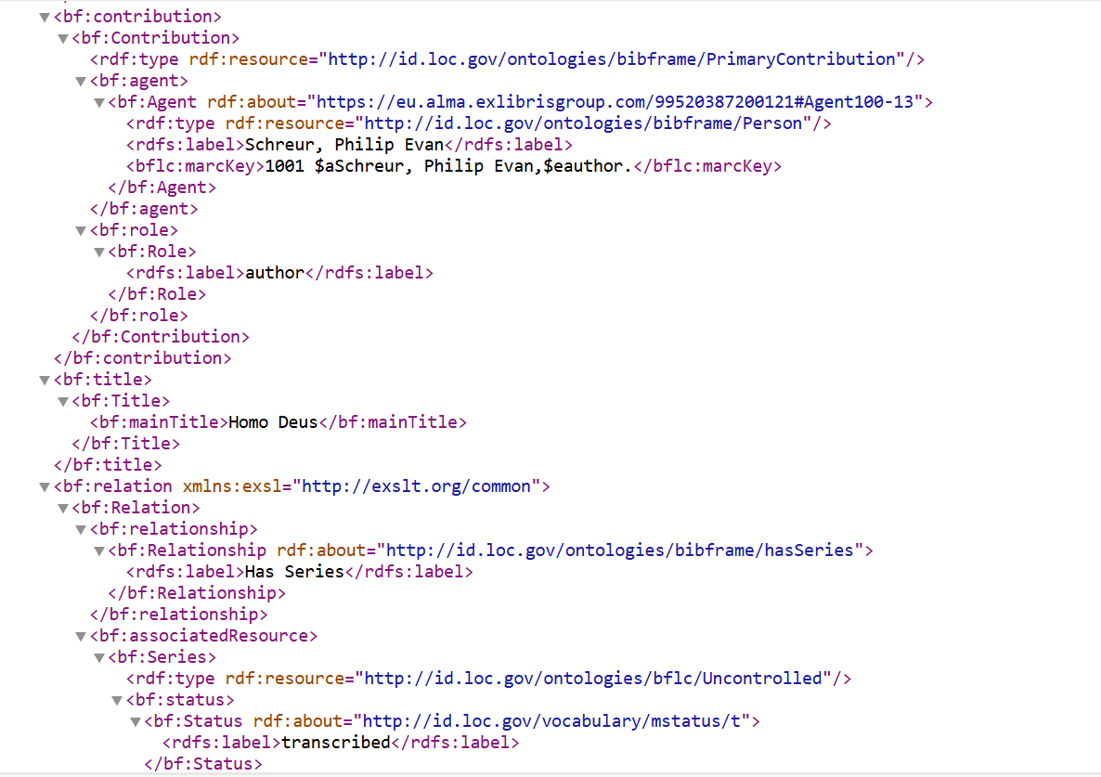
Using the APIs
Here is part of the first record in BIBFRAME using
https://open-na.hosted.exlibrisgroup.com/alma/EXLDEV1_INST-eu/bf/entity/instance/99520387200121

Slide 19
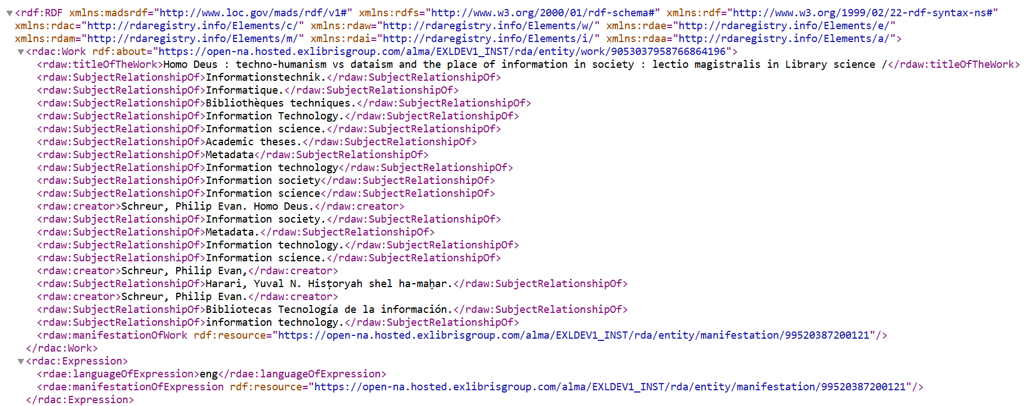
Using the APIs
Here is part of the first record in RDA using
https://open-na.hosted.exlibrisgroup.com/alma/EXLDEV1_INST-eu/rda/entity/manifestation/99520387200121

Slide 20
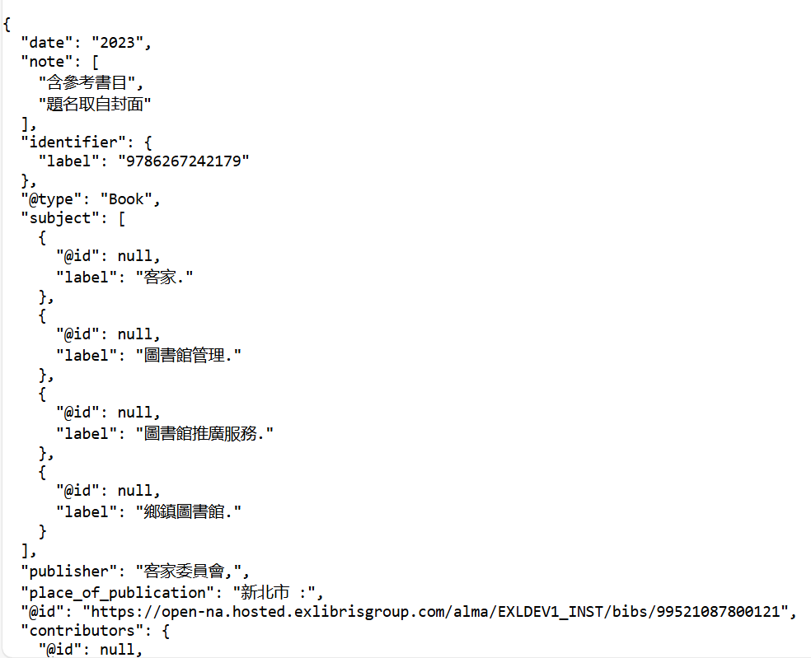
Using the APIs
Here is part of the second record in JSONLD using
https://open-na.hosted.exlibrisgroup.com/alma/EXLDEV1_INST-eu/bibs/99521087800121.jsonld

Slide 21
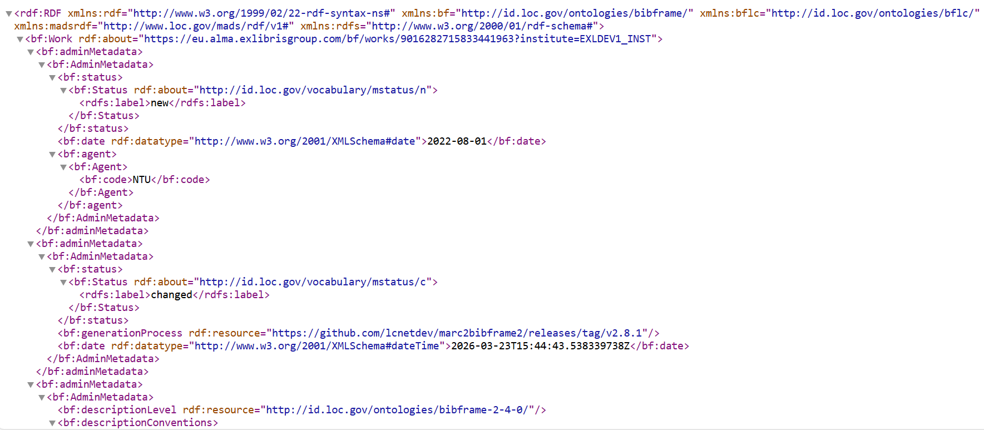
Using the APIs
Here is part of the second record in BIBFRAME using
https://open-na.hosted.exlibrisgroup.com/alma/EXLDEV1_INST-eu/bf/entity/instance/99521087800121

Slide 22
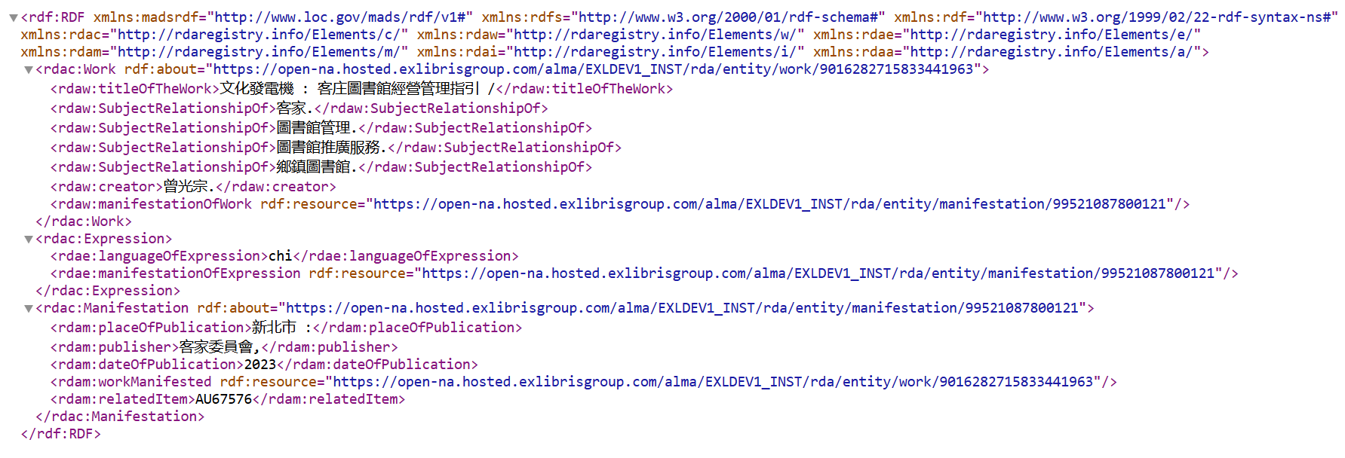
Using the APIs
Here is part of the second record in RDA using
https://open-na.hosted.exlibrisgroup.com/alma/EXLDEV1_INST-eu/rda/entity/manifestation/99521087800121

Slide 23
Using the APIs in National Taiwan University

Slide 24
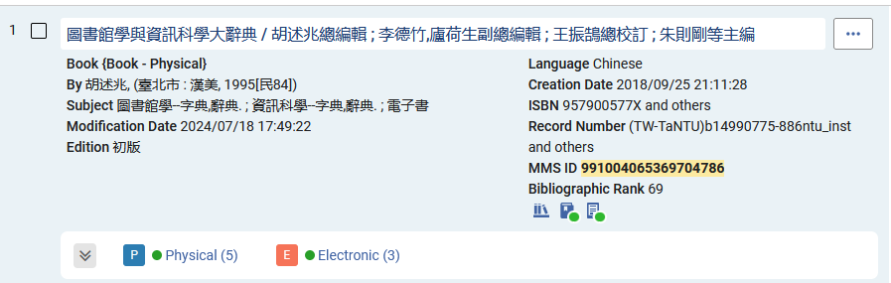
Using the APIs in National Taiwan University
We will now use these same APIs for MMSID 991004065369704786 at the National Taiwan University (institution code 886NTU_INST)

Slide 25
Using the APIs in National Taiwan University
The syntax will be:
For format JSONLD
  https://open-na.hosted.exlibrisgroup.com/alma/886NTU_INST/bibs/991004065369704786.jsonld
For format BIBFRAME
  https://open-na.hosted.exlibrisgroup.com/alma/886NTU_INST/bf/entity/instance/991004065369704786
For format RDA
  https://open-na.hosted.exlibrisgroup.com/alma/886NTU_INST/rda/entity/manifestation/991004065369704786

Slide 26
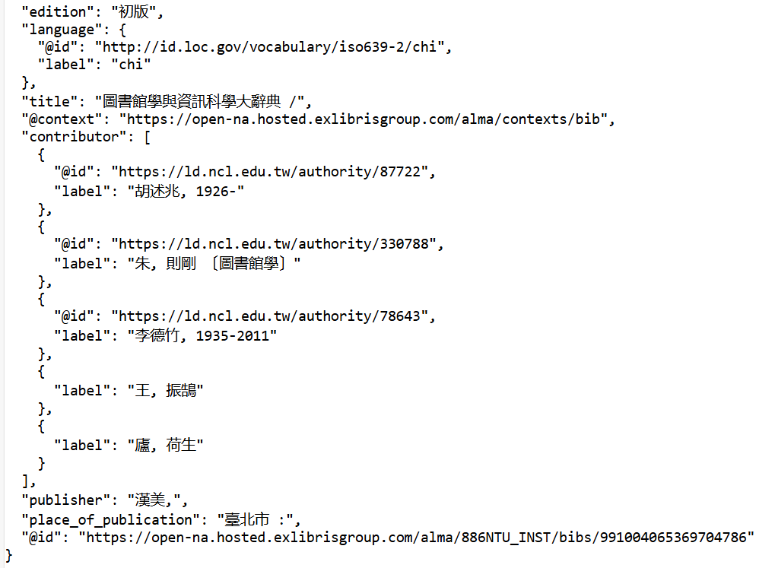
Using the APIs in National Taiwan University
JSONLD
https://open-na.hosted.exlibrisgroup.com/alma/886NTU_INST/bibs/991004065369704786.jsonld

Slide 27
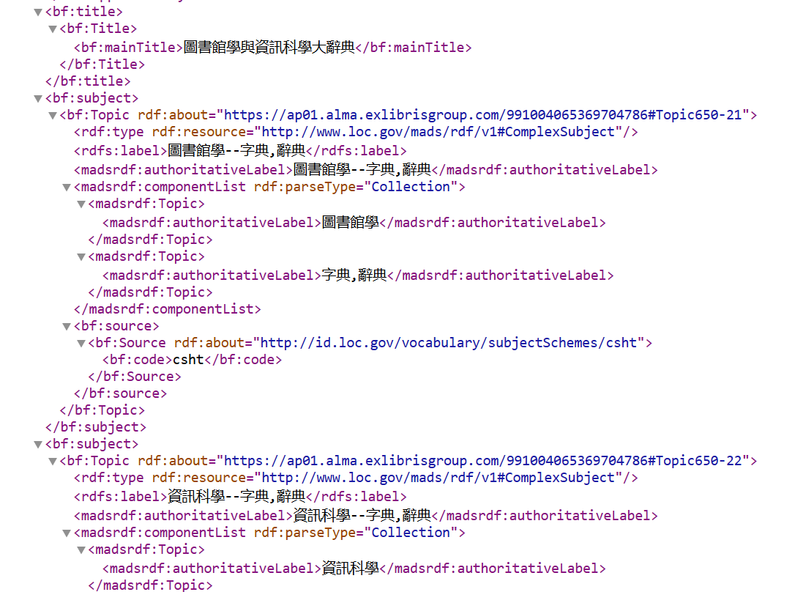
Using the APIs in National Taiwan University
BIBFRAME
https://open-na.hosted.exlibrisgroup.com/alma/886NTU_INST/bf/entity/instance/991004065369704786

Slide 28
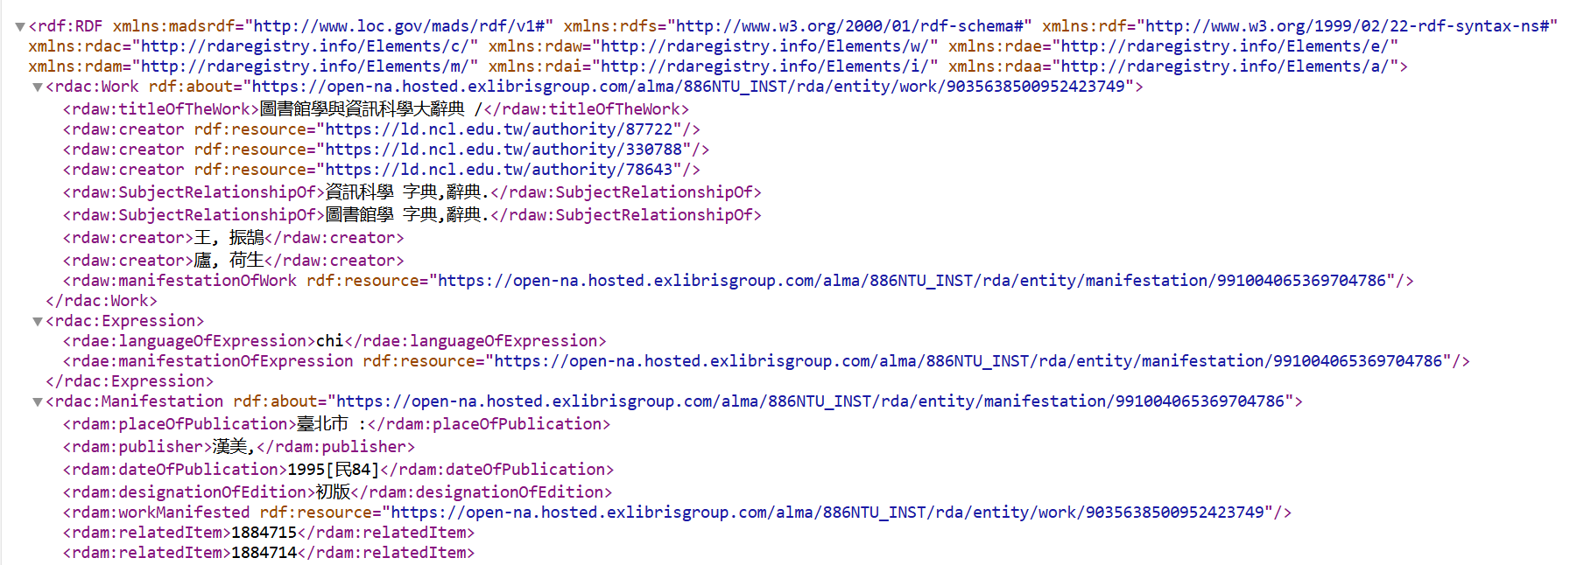
Using the APIs in National Taiwan University
RDA
https://open-na.hosted.exlibrisgroup.com/alma/886NTU_INST/rda/entity/manifestation/991004065369704786

Slide 29
Thank You

